Slide 1

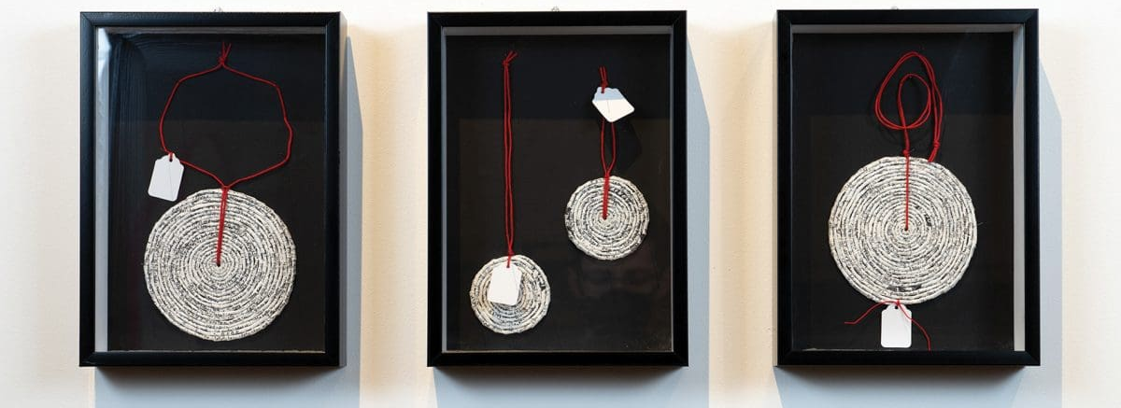

Slide 2
Artists often encode meaning using visual codes such as pattern, repetition, deconstructed text, and symbolic motifs.
Symbols go beyond words—shapes, motifs, materials, and repetition carry meaning
Cultural Symbols in Art may include:
Totemic animals
Traditional patterns
Glyphs, icons, family crests
Cultural or ancestral materials (earth, bark, pulp, thread)
Language in Art:
Can be literal (text and script) or abstract (marks and symbols)
Can symbolise inclusion or exclusion, clarity or confusion
Fragmented or recontextualised language reflects cultural loss, recovery, or transformation
Purpose of Visual Codes:
Convey identity, memory, spirituality, protest
Reclaim erased or silenced histories
Layer meaning beyond the literal
Create space for interpretation
What visual signs or phrases have personal meaning to you? What happens when text is erased, broken, or hidden in an artwork?

Slide 3
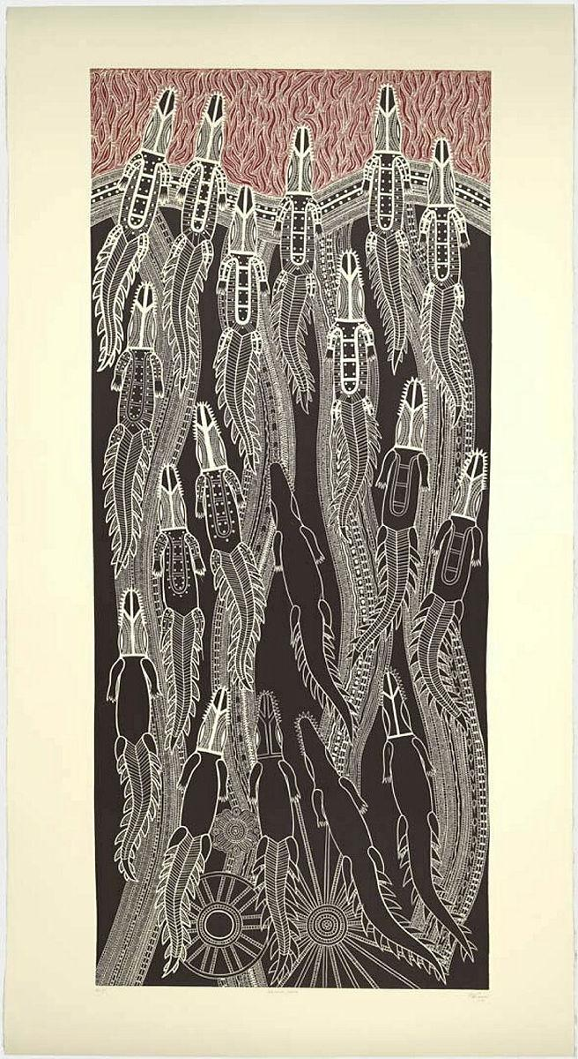
TEHO ROPEYARN
Theme: Ancestral memory, land, and strength
Art as Code: Visual languages inherited from ancestors, used to map identity and place
Formal Context: Pattern, repetition, linocut technique
Cultural Context: Torres Strait Islander tradition and symbolism (crocodile, land and sea motifs)
How does Ropeyarn use traditional symbols and repetition to show strength and connection to place?
Inquiry Process:
Developing: Explores ancestral motifs as compositional framework
Researching: Investigates kinship systems, geography, and totems
Reflecting: Uses traditional designs to represent personal identity
Resolving: Final works communicate strength and resilience through repeated symbols
Mandang Ikamba (Strength of a crocodile)
2020, vinyl linocut on paper

Slide 4
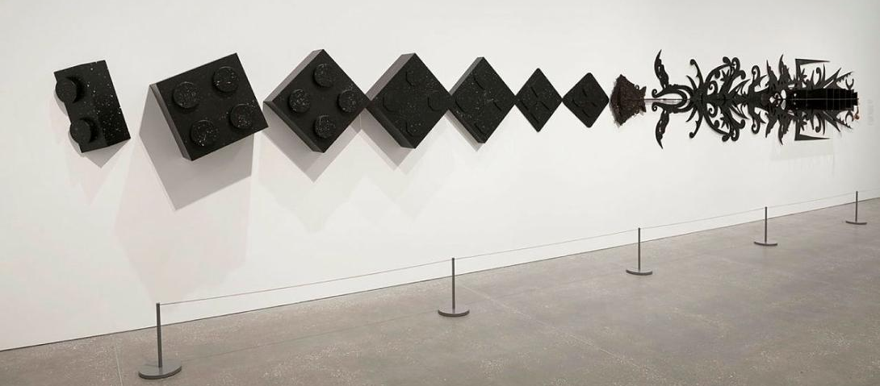
BRIAN ROBINSON
Theme: Fusion of Indigenous storytelling and global pop culture
Art as Code: Stars, constellations, masks, and traditional iconography collide with Western narrative figures.
Formal Context: Graphic detail, lino printing, sharp contrast
Cultural Context: Torres Strait Islander cosmology and classical mythology
Inquiry Process:
Developing: Fuses dual narratives into one frame
Researching: Studies both cultural mythologies
Reflecting: Positions Indigenous knowledge at the centre of visual storytelling
Resolving: Uses symbolic fusion to reflect dual identity
In what ways does Robinson's blending of pop culture and traditional iconography act as a form of visual storytelling?
MXXlllVlllMCMLXXlll | XVllVllMCMXVll [When worlds collide] 2012,
Mixed media (PVC plastic, enamel spray paint, medium density fibreboard, pine timber, raffia, feathers [cassowary, duck & bird], shells [cowrie])

Slide 5
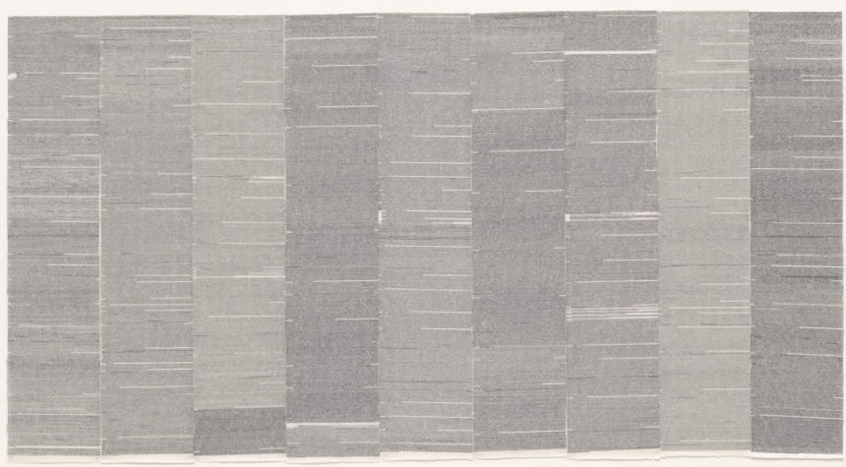
SIMRYN GILL
Theme: Language loss, migration, and postcolonial identity
Art as Code: Torn books and reassembled fragments symbolise memory and dislocation
Formal Context: Deconstructed text, repetition, fragmentation
Cultural Context: Displacement, memory, cultural silence
How does Gill use broken and reassembled text to reflect ideas of migration and memory?
Inquiry Process:
Developing: Experiments with disassembling language
Researching: Investigates personal migration histories
Reflecting: Abstracts meaning through mark and removal
Resolving: Final works act as quiet expressions of absence
Where to draw the line, 2011-12, Typewriting on nine sheets of paper

Slide 6


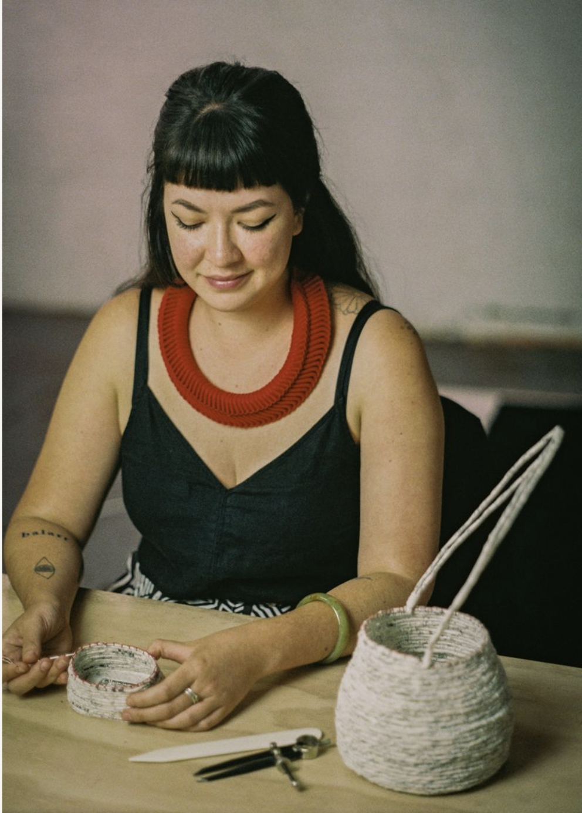
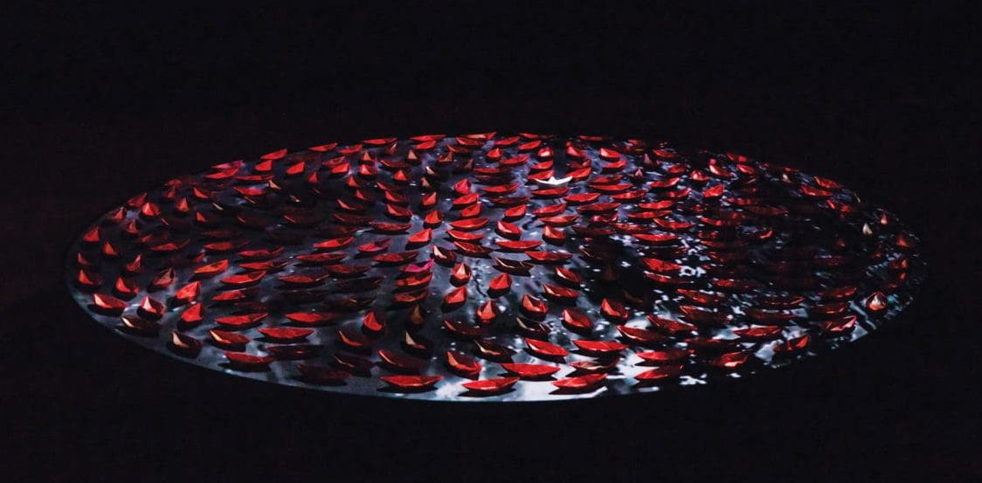
Jenna Lee is a contemporary Larrakia, Wardaman and KarraJarri artist who explores language, identity, and memory through paper, fibre, and found text. Her practice reclaims colonial and archival materials—like government reports or dictionaries—and transforms them into soft, fragile, and powerful works of art.
She often pulps text into new forms, uses thread to weave memory, and incorporates repetition and Indigenous design principles. Her art becomes a visual language of cultural resilience and reclamation.
JENNA LEE un/bound passage, 2019, hand-dyed and folded paper installation from pages of ‘The Voyages of Captain Cook’
Key Themes in Lee's Work:
Reclamation of erased language and cultural memory
Transformation of colonial text into Indigenous knowledge
Fragility and strength through natural and recycled materials
Use of repetition and handmade techniques to code stories
Exploration of cultural duality and resistance through form

Slide 7
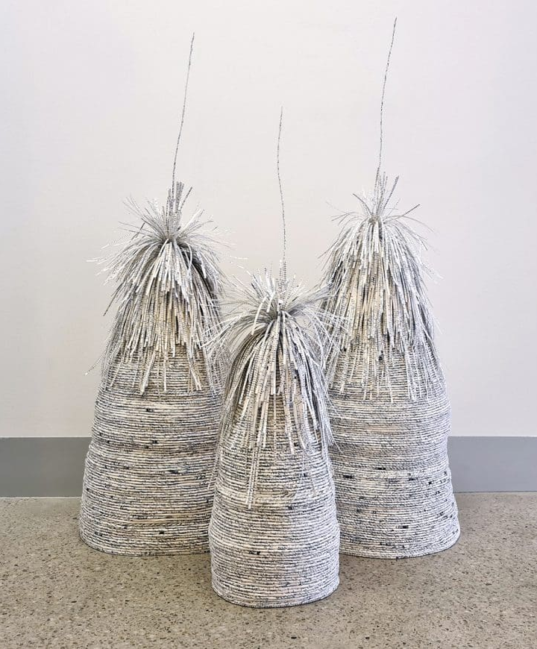
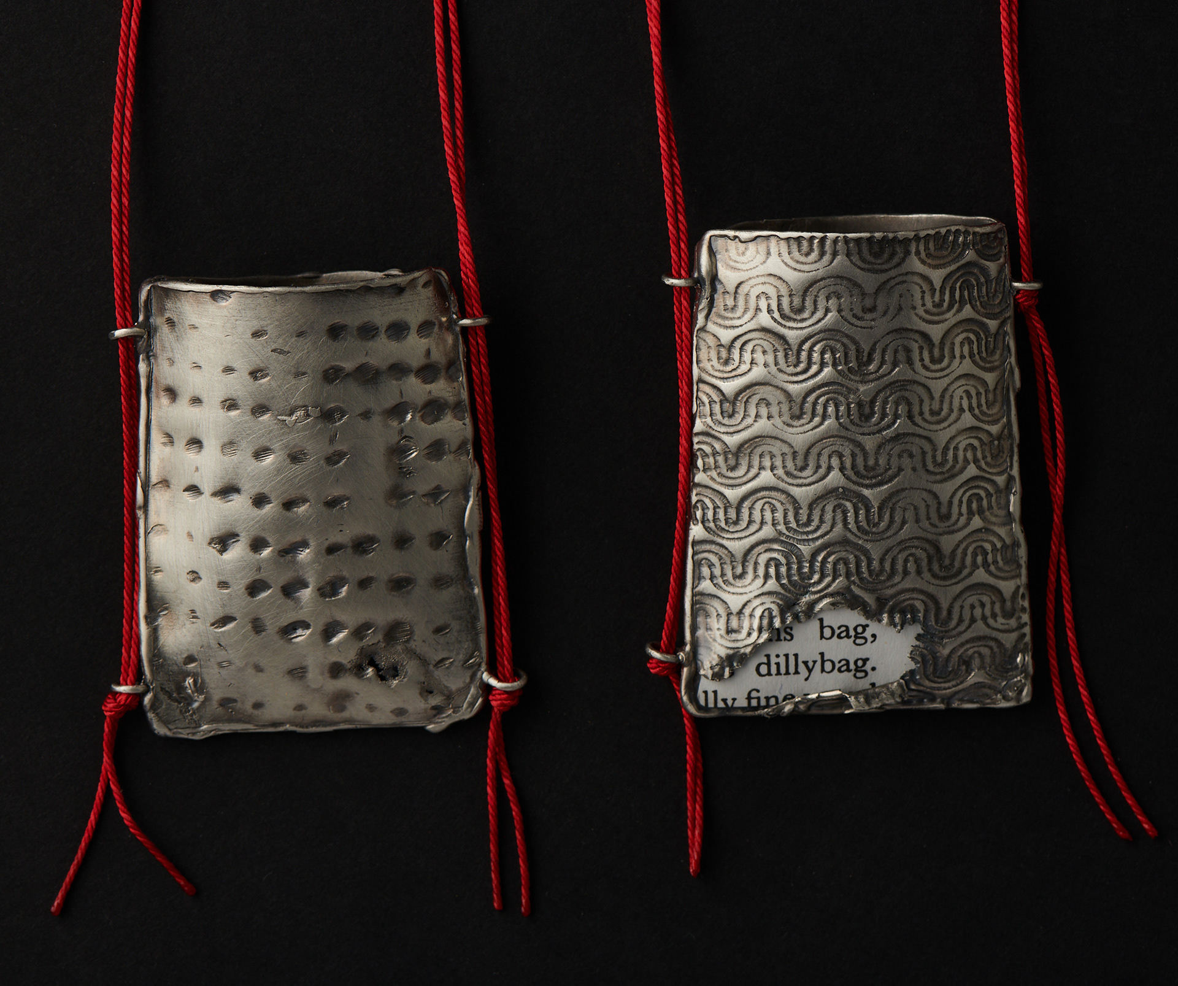
Inquiry Process:
Developing: Begins with colonial or inherited texts and transforms them through cultural lens
Researching: Draws from family archive and First Nations language reclamation
Reflecting: Interweaves symbolism and fragility into personal and cultural storytelling
Resolving: Completes poetic, layered works that speak through absence, material, and transformation
How does Jenna Lee symbolically rework found text and fibre to reclaim cultural identity and story?
Formal Context: Lee’s art is defined by her use of paper, fibre, repetition, and delicate scale. She removes or recontextualises text, using neutral tones and materials like string or pulp to reflect fragility, resilience, and care. Her compositions are minimal yet symbolic—layered with personal and cultural meaning.
Cultural Context: Lee’s practice is grounded in her identity as a Larrakia woman and her experience of cultural duality. She reclaims government texts and repurposes institutional materials, challenging the systems that sought to erase First Nations knowledge. Her work repositions language as a vessel for memory and sovereignty.

